Slide 1

Understanding Proportional Representation:
How It Might Work in Montreal

Slide 2
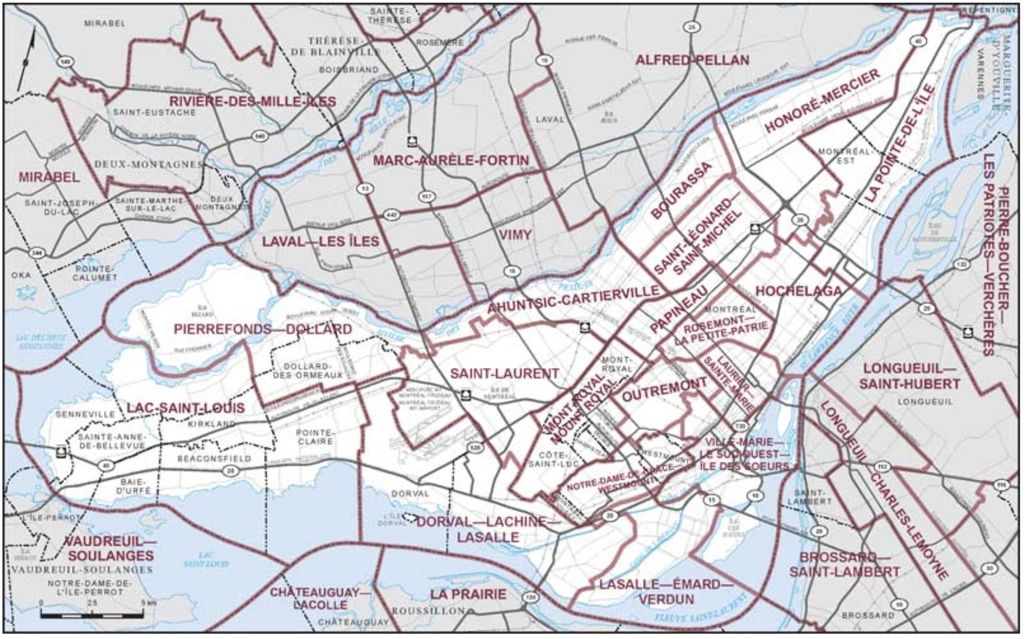

Island of Montreal, 2019 Election
There are 18 ridings on the Island
Each figure represents ~10,000 voters

Slide 3

Island of Montreal, 2019 Election
In each riding, the candidate with the most votes won
Elected MPs are shown as large figures

Slide 4
Results with First Past the Post
Liberals win all but two seats (90%) with <50% of the vote

Slide 5
Voters Who Voted for Their MP
Mainly Liberal supporters
A few BQ and NDP supporters
No Conservative or Green supporters

Slide 6
Unrepresented Voters
Mostly non-Liberal supporters

Slide 7
Results With Proportional Voting
Imagine MPs elected in proportion to how voters voted
MPs (large figures) overlaid on voter distribution
Note: This illustrates a likely result from using
either the Single Transferable Vote or List PR

Slide 8
Likely Results with Proportional Voting
Liberals win 9 of 18 seats (50%) with 49% of the vote
~ 1 MP per 50,000 voters

Slide 9
Likely Results with Proportional Voting
Conservatives win 2 of 18 seats (11%) with 10% of the vote

Slide 10
Likely Results with Proportional Voting
Bloc Quebecois wins 3 of 18 seats (17%) with 18% of the vote

Slide 11
Likely Results with Proportional Voting
NDP wins 3 of 18 seats (17%) with 16% of the vote

Slide 12
Likely Results with Proportional Voting
Green Party wins 1 of 18 seats (5%) with 6% of the vote

Slide 13
Results With Mixed Member Proportional
9 members elected with Single Member Districts (shown)
9 members elected regionally (next slide)
Note: For illustrative purposes only, we have paired existing
ridings. In reality, an Electoral Boundaries Commission would determine the appropriate riding boundaries, and the mix of district and list seats might be different (eg, 11+7).

Slide 14
MMP – MPs Elected From Regional List
List MPs would be elected to ensure that the total number of MPs elected from the region closely match the overall levels of support amongst the voters.

Slide 15

Comparison of Outcomes
How Voters Voted:
MPs With FPTP:
MPs With Pro Rep:

Slide 16
Learn More:
Fair Voting BC - fairvotingbc.com, facebook.com/fairvotingbc
Charter Challenge – charterchallenge.ca, facebook.com/charterchallenge
Fair Vote Canada - fairvote.ca, facebook.com/FairVoteCanada
PR Discussion Group - facebook.com/groups/ProportionalRepresentationCanada
Wasted Votes - wastedvotes.ca
UK Electoral Reform Society - electoral-reform.org.uk
Fair Vote USA - fairvote.com
Proportional Representation Society of Australia - prsa.org.au
ACE Electoral Knowledge Network - aceproject.org (international)
Institute for Democracy and Electoral Assistance - idea.int (international)

